Slide 1
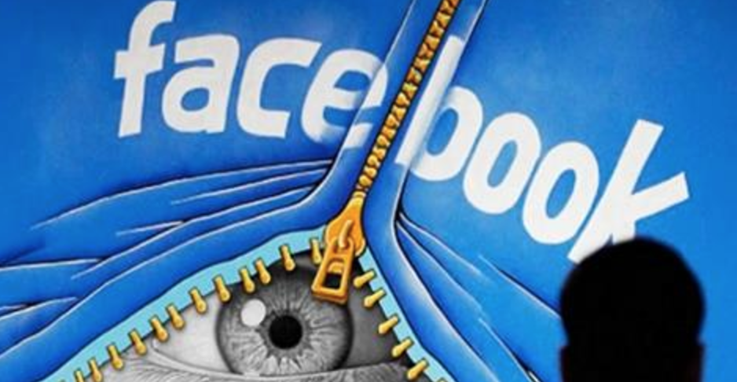
DECENTRALIZING SOCIAL MEDIA:
HOW LIBRARIES CAN
DESTROY

Slide 2
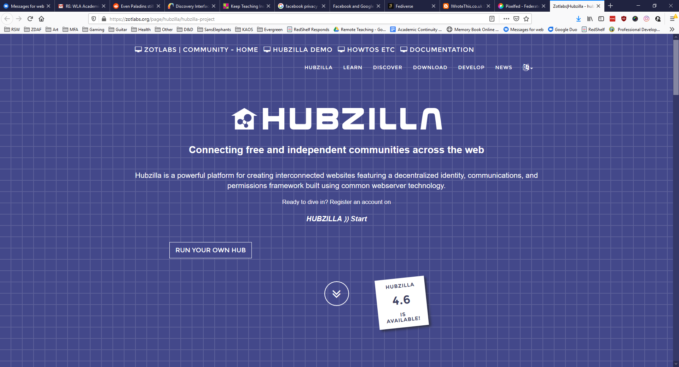

Slide 4
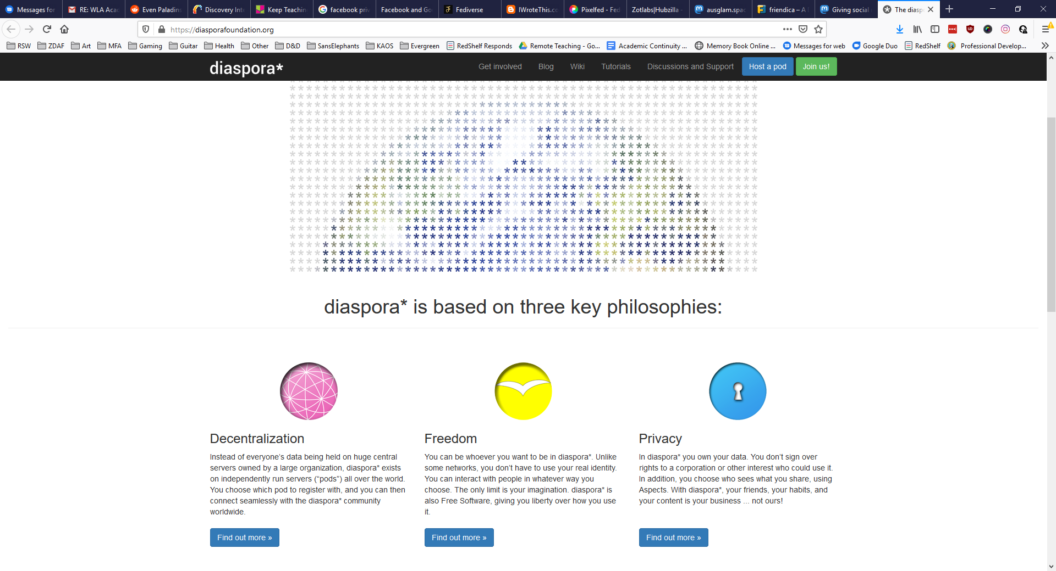

Slide 5
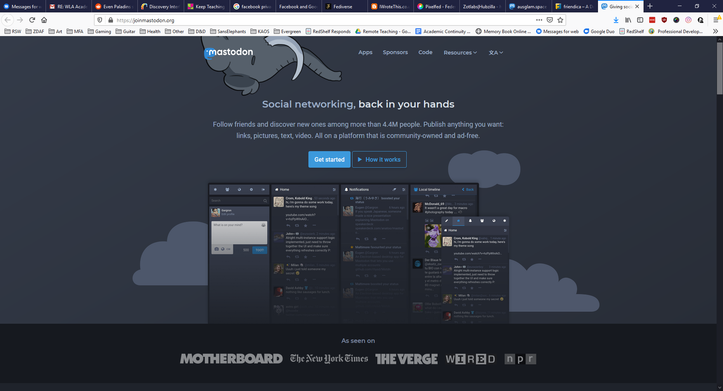

Slide 6
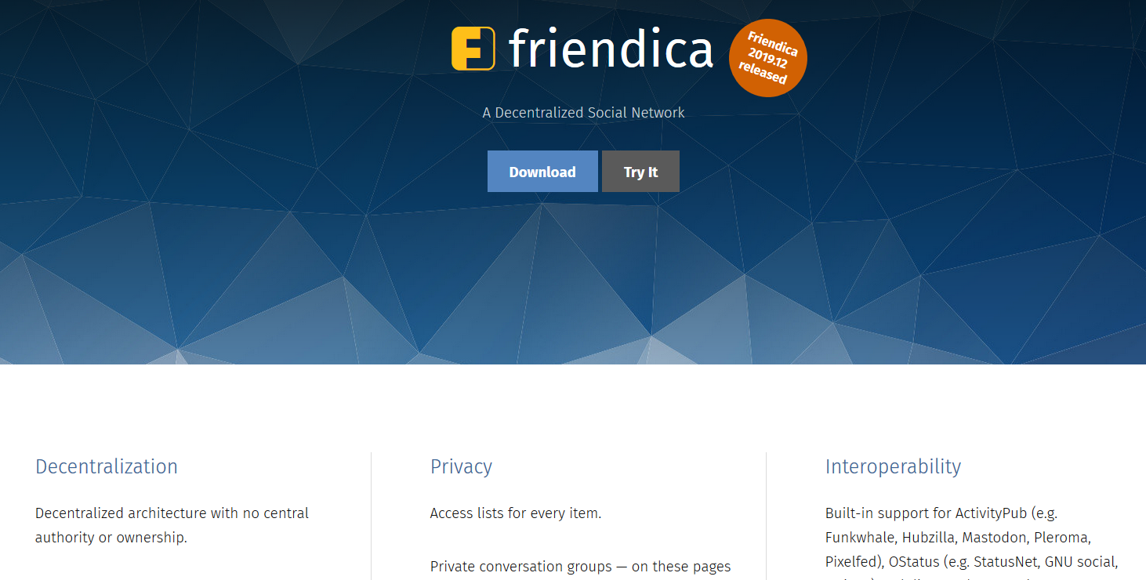

Slide 8
outofthelibrary.com/

